Slide 1
Network Security and its Role In Cyber Security
Strengthening Cyber Defenses: The Vital Importance of Network Security in Cybersecurity.

Slide 2
Introduction
Welcome to the world of modern connectivity, where computers are not just standalone machines, but interconnected entities that drive the global digital revolution.
Computer networking, the backbone of our digital infrastructure, has transformed the way we communicate, collaborate, and share information. From the internet that connects continents to local area networks (LANs) in our homes and offices, networking has become integrated into our lives.
In this era of unprecedented technological advancements, the importance of computer networking in cyber security cannot be overstated.
Cyber threats loom large, posing a constant challenge to the security and integrity of our digital systems. As we become increasingly reliant on technology, the need to protect our networks from malicious actors and potential vulnerabilities becomes paramount.

Slide 3
Introduction (CTD)
In this project, we will delve into the intricacies of computer networking and explore its crucial role in safeguarding against cyber threats.
We will examine the fundamental concepts of networking, including protocols, architectures, and technologies, that enable seamless communication between devices. We will also analyze the various types of cyber threats, such as malware, ransomware, and phishing attacks, that can compromise network security.
Furthermore, we will explore the key principles of cyber security, including confidentiality, integrity, availability, and authentication, and how they are applied in the context of computer networking.
We will also delve into the best practices for securing networks, including firewalls, virtual private networks (VPNs), intrusion detection systems (IDS), and encryption techniques.

Slide 4
Introduction (ctd)
We will also analyze the evolving landscape of cyber threats and the emerging technologies that are shaping the future of computer networking and cyber security.
In conclusion, computer networking is not just about connecting devices, but also about protecting them from potential cyber threats. Understanding the principles of networking and cyber security is critical in today's digital age, where data breaches and cyber attacks are rampant. Join us on this fascinating journey as we unravel the intricate world of computer networking and its significance in safeguarding our digital world.

Slide 5
What is computer networking?
Computer networking refers to the process of connecting computing devices together to facilitate communication and data exchange. It enables the transfer of data and information between devices, allowing people to share resources and work together effectively.

Slide 6
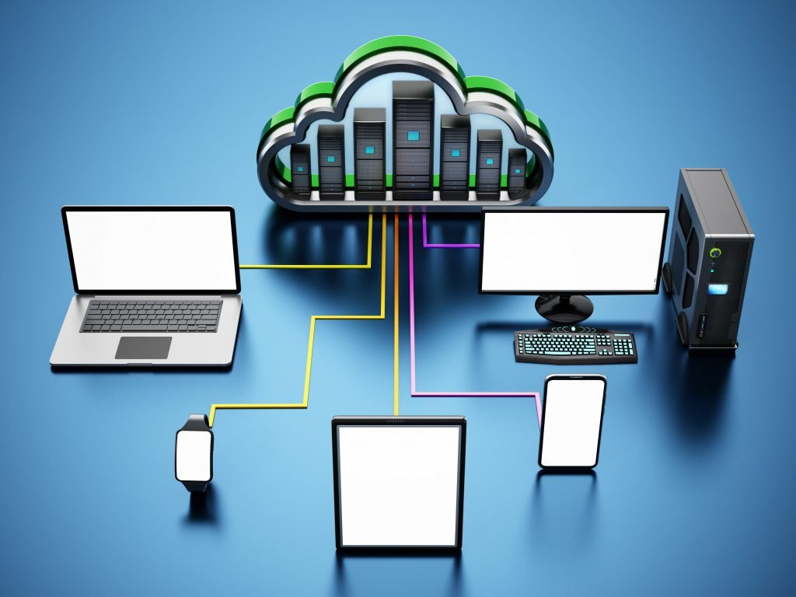
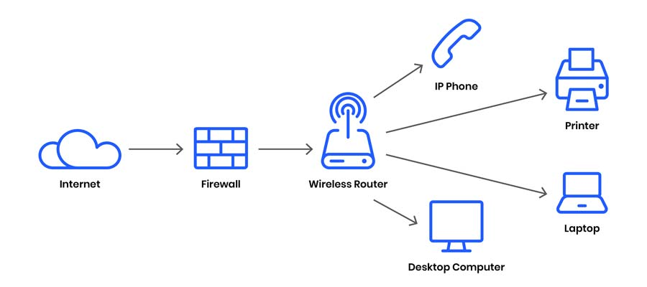
Computer Networking (ctd)

Slide 7
Computer Networks and cyber security
In cyber security, computer networking is essential in protecting networks from various cyber threats, such as unauthorized access, malware, and data breaches.
By securing network infrastructures, organizations can reduce the risk of cyber attacks and protect sensitive information.
According to an article published in the Journal of Computer Science & Technology, computer networks are "critical infrastructures" that require adequate security measures to protect against potential vulnerabilities and attacks (Feng et al., 2019).
A study conducted by the National Institute of Standards and Technology (NIST) also emphasized the importance of implementing security controls and best practices to ensure the confidentiality, integrity, and availability of network resources (NIST, 2018).

Slide 8
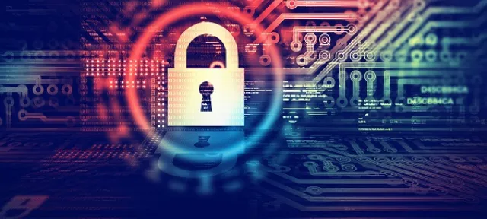
“Cyber is the real domain of power”

Slide 9
Types of Networks
Networks are divided into various types, which cover a variety of ranges and may be used for varying purpose.
This section will seek to explain these networks and how they work.

Slide 10
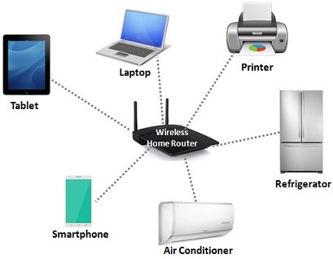
LAN (Local Area Network)
A LAN is a network that connects devices in a limited geographic area, such as an office, building, or campus.

Slide 11
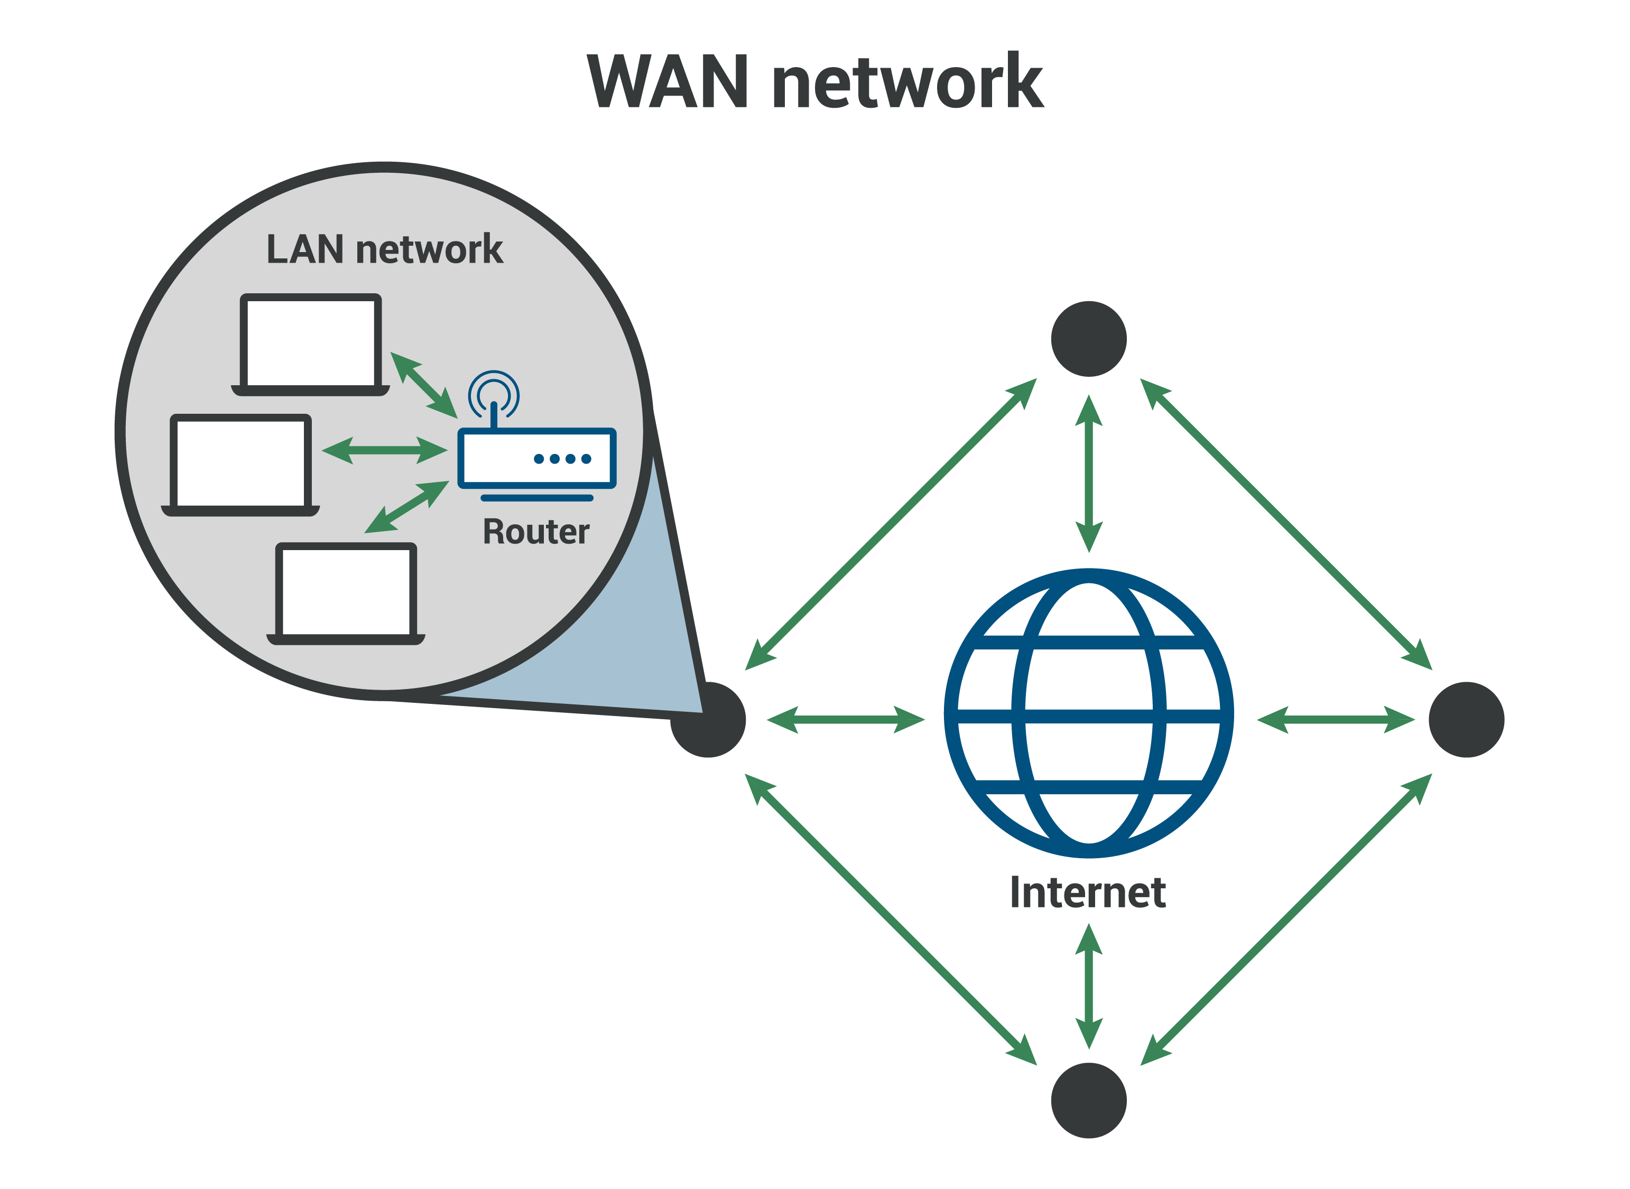
WAN (Wide Area Network)
A WAN is a network that connects devices over a wide geographic area, such as different cities or countries.

Slide 12
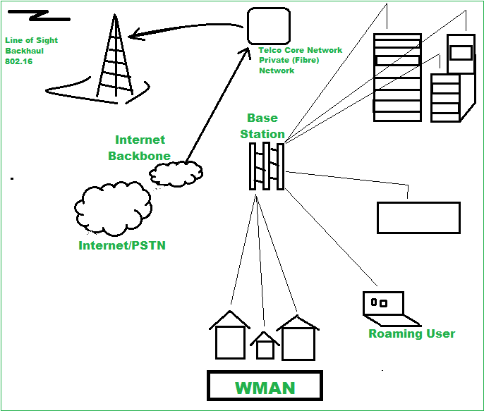
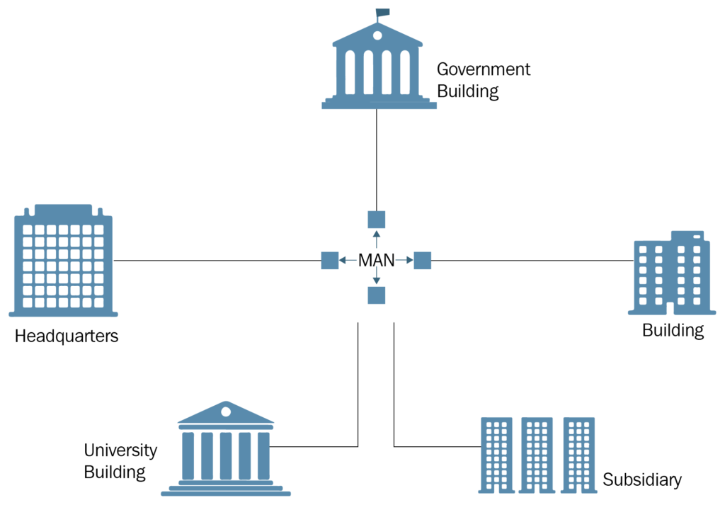
MAN (Metropolitan Area Network):
A MAN is a network that connects devices within a metropolitan area, such as a city.

Slide 13
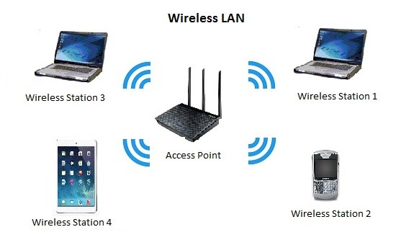
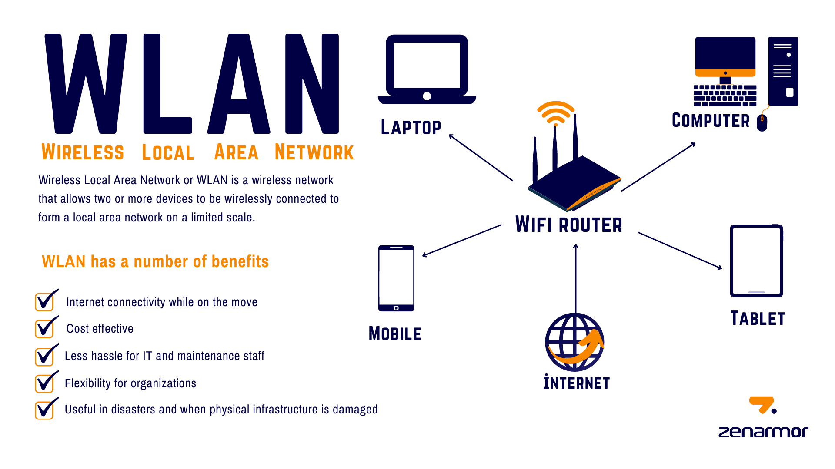
WLAN (Wireless Local Area Network)
A WLAN is a LAN that uses wireless communication to connect devices, typically using Wi-Fi technology.

Slide 14
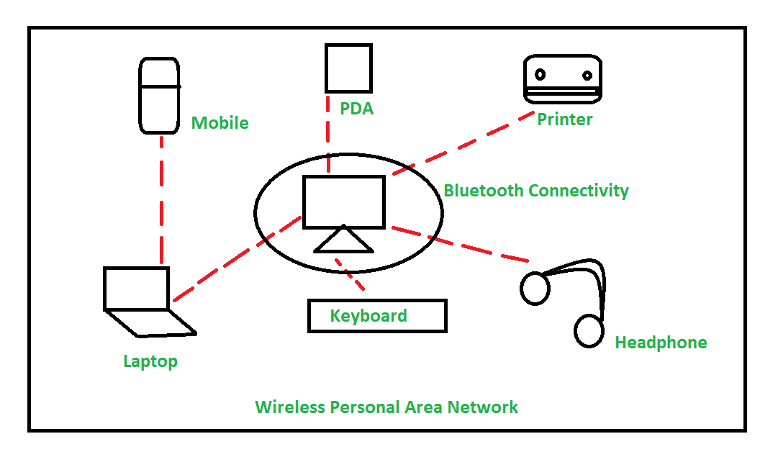
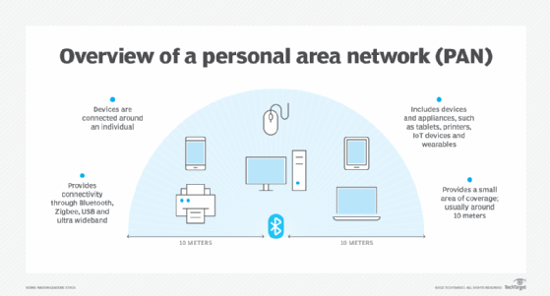
PAN (Personal Area Network)
A PAN is a network that connects personal devices, such as smartphones, tablets, and laptops, over a short distance using Bluetooth or other wireless technologies.

Slide 15
What is a Network topology?
A network topology is the physical and logical arrangement of nodes and connections in a network.
It is an application of graph theory wherein communicating devices are modeled as nodes and the connections between the devices are modeled as links or lines between the nodes.
Physical topology refers to device location and cable installation while logical topology illustrates how data flows within a network.

Slide 16
Types Of Network topologies
The different network topologies include:

Slide 17
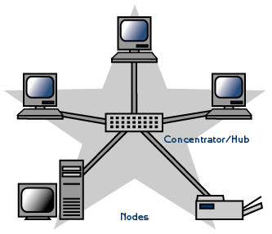
Star topology
In a star topology, devices are connected to a central hub or switch, which acts as a central point of communication.

Slide 18
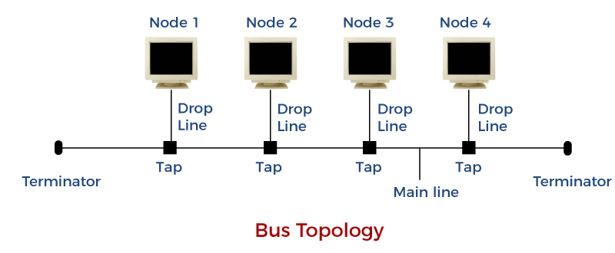
Bus Topology
In a bus topology, devices are connected to a single communication line, called a bus, that carries data between devices.

Slide 19
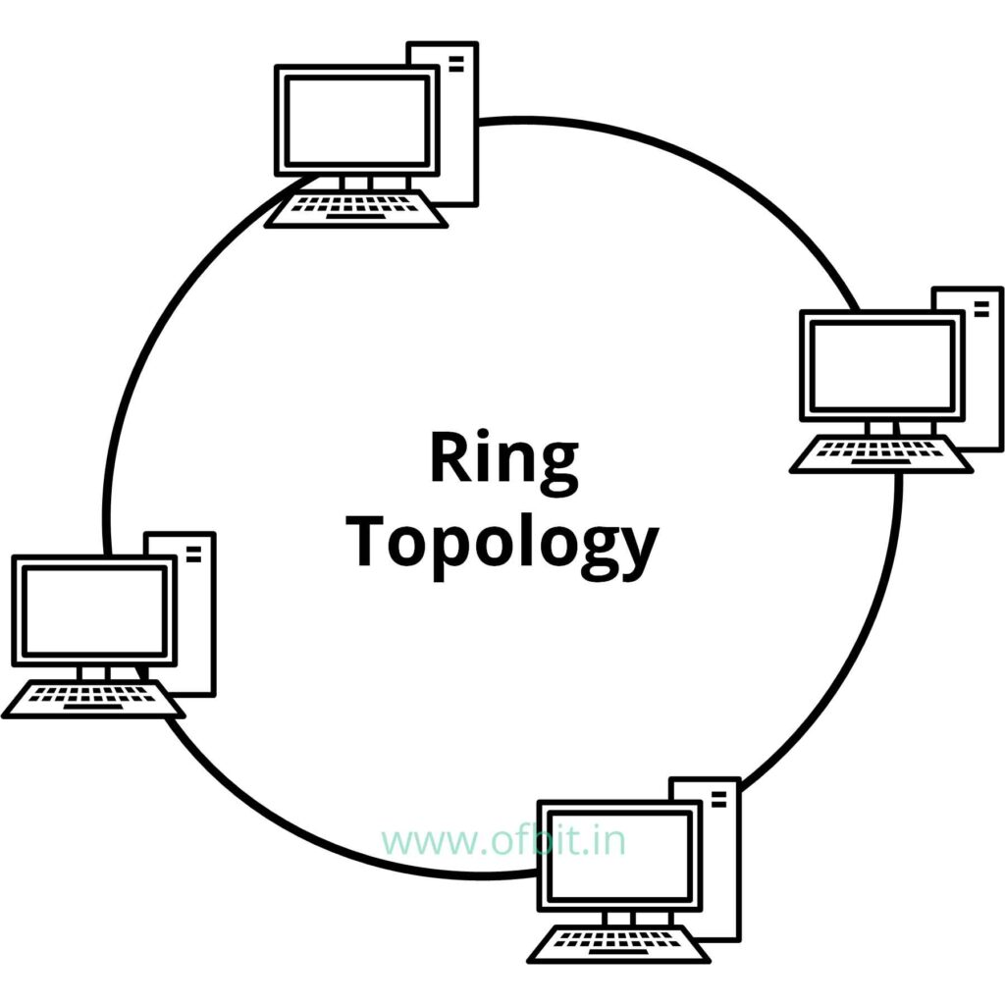
Ring Topology
In a ring topology, devices are connected in a circular fashion, with data flowing in one direction around the ring.

Slide 20
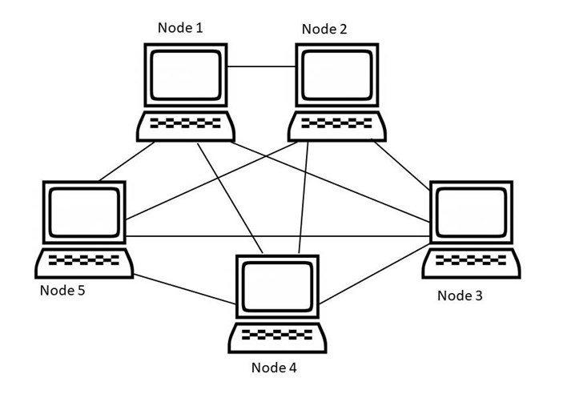
Mesh Topology
In a mesh topology, devices are connected to multiple other devices, creating a redundant network with multiple paths for data to travel.

Slide 21
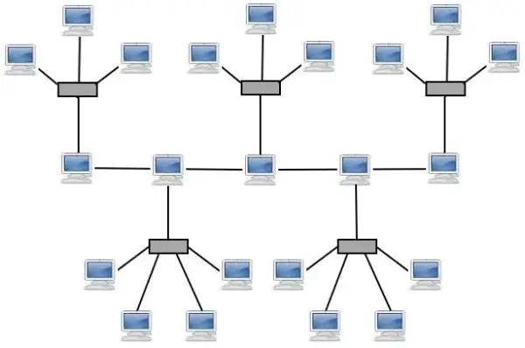
Hybrid Topology
A hybrid topology combines multiple network topologies, such as a star-bus or ring-mesh topology.

Slide 22
What are Networking devices?
A networking device is a type of hardware that operates in a network, such as modems, routers and switches.
It is used to connect devices or computers together to transfer resources or files like fax machines or printers.
Networking devices play a critical role in the functioning and security of computer networks.

Slide 23
Types of network devices
Some of the commonly used networking devices include:

Slide 24
Routers
: Routers are devices that connect different networks together, allowing devices on different networks to communicate with each other.
They also help in directing network traffic and filtering out unwanted traffic.

Slide 25
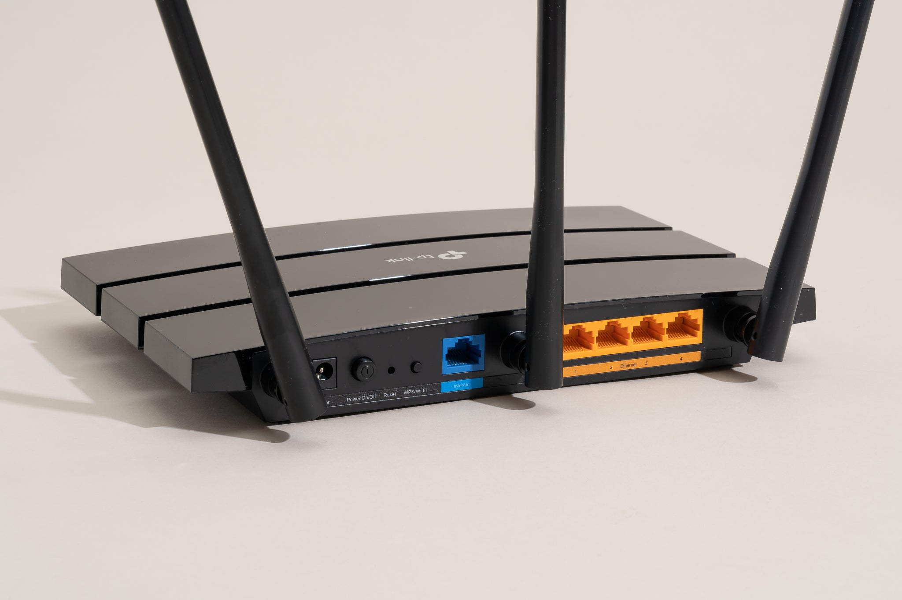
Routers (ctd)

Slide 26
Switches
Switches are devices that connect devices within a network, allowing them to communicate with each other.
They help in directing network traffic and optimizing network performance.

Slide 27
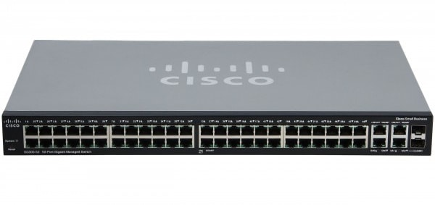
Switches (ctd)

Slide 28
Hubs
Hubs are devices that connect devices within a network, but they do not direct network traffic.
Instead, they simply broadcast incoming traffic to all devices on the network.

Slide 29
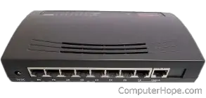
Hubs (ctd)

Slide 30
Firewalls
Firewalls are devices that protect networks from unauthorized access, malware, and other cyber threats.
They can be hardware or software-based and work by filtering incoming and outgoing network traffic based on predefined security policies.

Slide 31
Sources
Feng, Y., Yan, J., Huang, Z., & Wang, W. (2019). A survey on network security in industrial internet of things. Journal of Computer Science and Technology, 34(3), 463-478.
National Institute of Standards and Technology. (2018). NIST Special Publication 800-53, Revision 5: Security and Privacy Controls for Information Systems and Organizations.

